Slide 1
Data Visualization Dashboard for Manufacturing Plant and Industrial Safety
DS 5110 Summer 2025
Qingyuan Hu, Yunmu Shu

Slide 2
Introduction
• Develop a dashboard for monitoring industrial accident trends.
• Visualize patterns in accident frequency, causes, and severity.
• Enable interactive data exploration by time and category.

Slide 3
Problem & Motivation
• Traditional reports and tables are ineffective for understanding complex safety data
• Industrial accident datasets are large, categorical, and contain free-text descriptions
• A dynamic, interactive dashboard can improve risk analysis and decision-making

Slide 4
Dataset overview
• Source: Kaggle – Industrial Safety and Health Analytics Database
• Volume: Around 36,000 accident records from 12 plants in 3 countries
• Fields:
Timestamps
Categorical attributes (industry, country, accident level, role)
Free-text descriptions (used for word cloud)

Slide 5
Techniques Used
• Plotly Dash for dashboard UI & layout
• WordCloud for text mining visualization and NLP on free-text descriptions
• PySpark SQL for data transformation and filtering
• Decision Tree for monthly accident prediction

Slide 6
Time Complexity Estimation
• Preprocessing: O(n)
• WordCloud generation: O(n * m) (n = records, m = avg word count)
• Decision Tree Training: O(n log n)
• Pandas DataFrame (in Dash)
• PySpark DataFrame (initial filtering)
• Dictionaries / lists (for plotting)

Slide 7
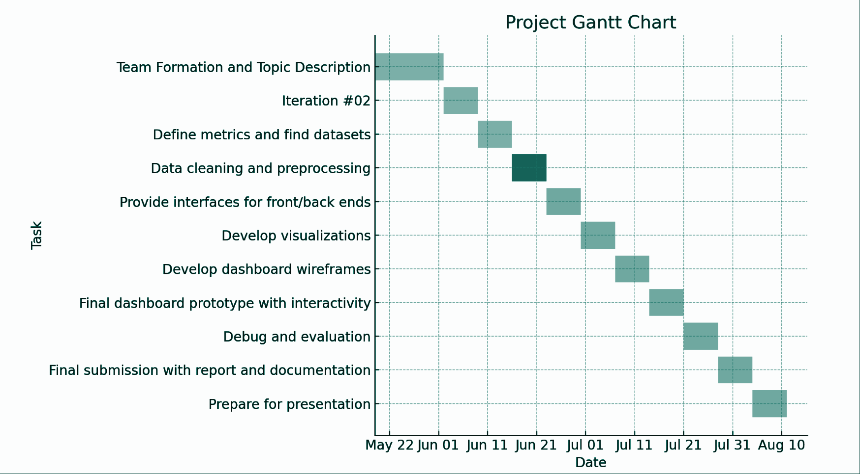
Project Timeline
• Break down to weekly tasks (About 4 hours / week)

Slide 8
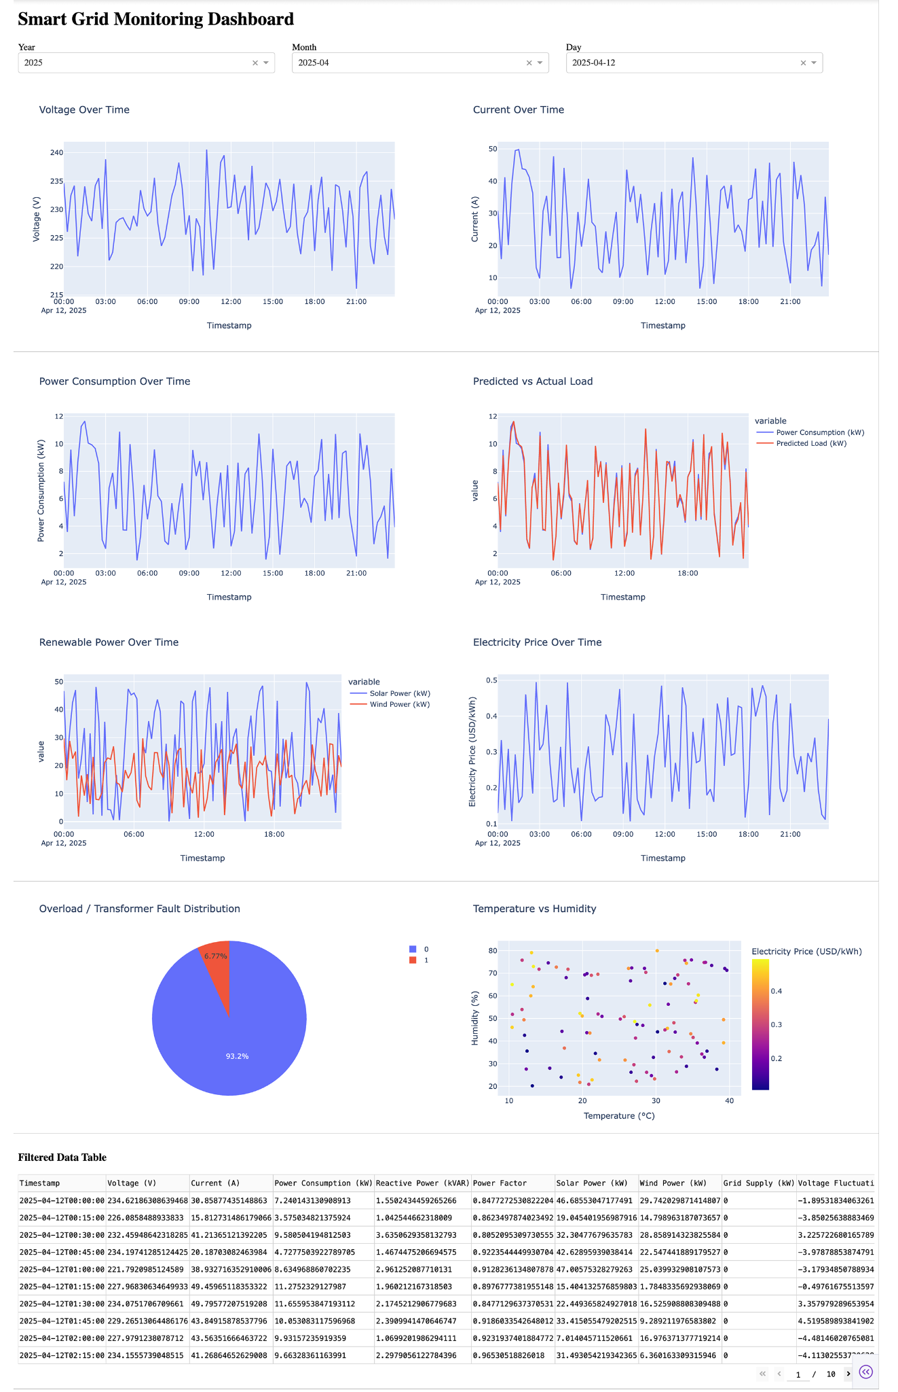
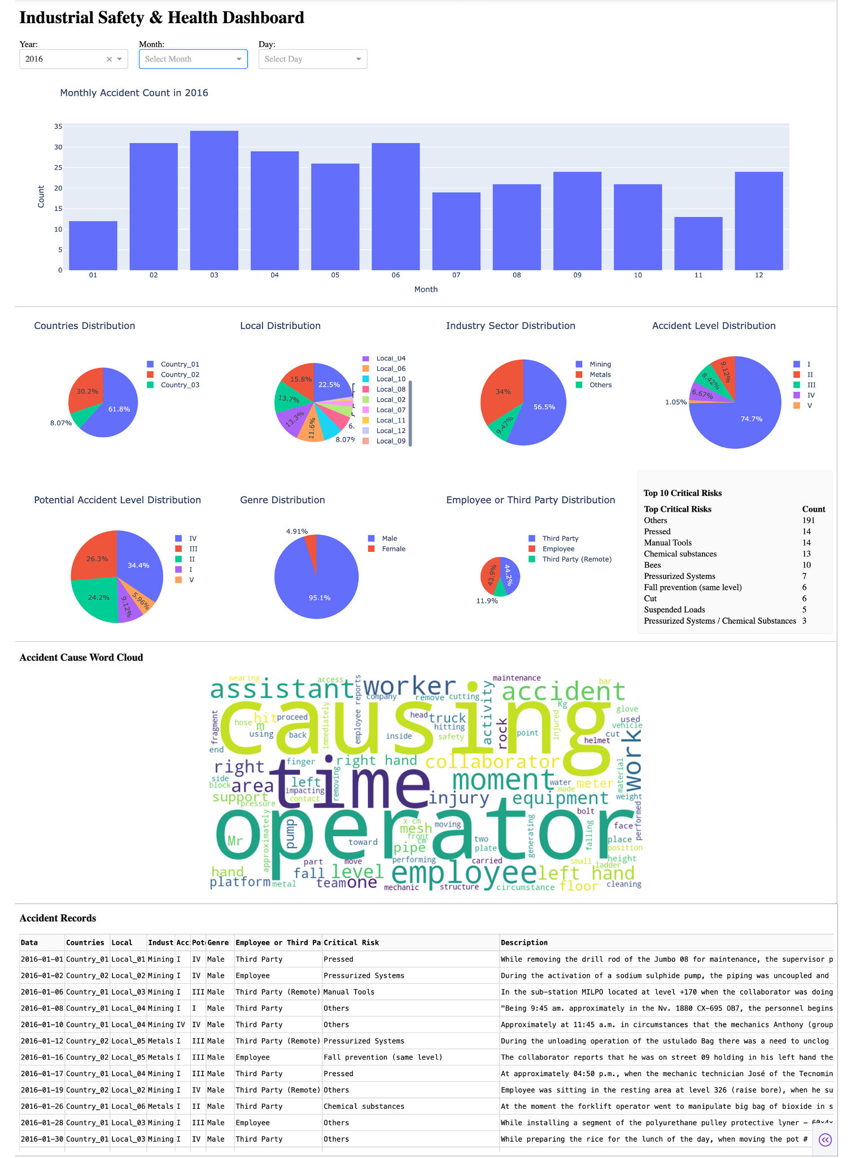
Analysis and Results - Dashboard Overview
Both:
• Year / Month / Day dropdown filters
• Original data table on the bottom
“Smart-Grid”:
• Line graphs to show temporal trends
"Industrial-Safety":
• Pie charts to show percentage distribution
"Smart-Grid" Dashboard
"Industrial-Safety" Dashboard

Slide 9
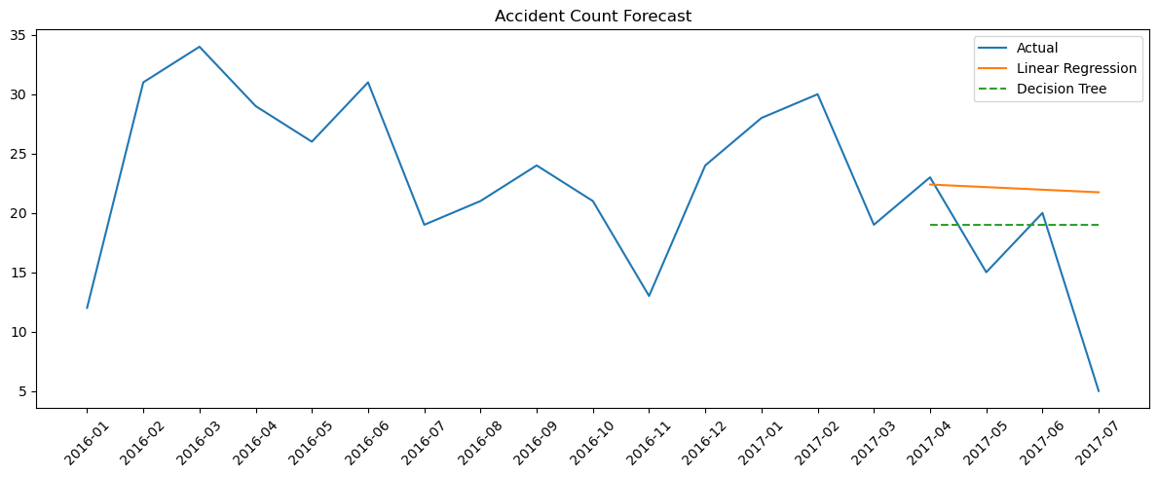
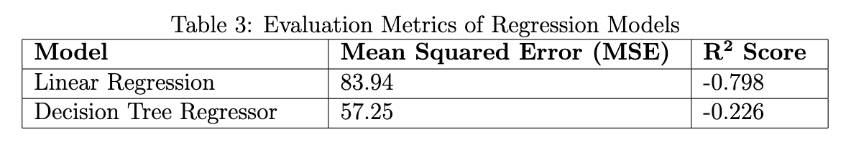
Analysis and Results - Accident Forecasting
• Forecasts monthly accident counts using historical data.
• Linear Regression provides a clear baseline.
• Decision Tree can capture non-linear trends better.

Slide 10
Discussion (1)
Implications of Findings:
• Interactive dashboards effectively communicate complex, multi-dimensional insights from both datasets.
• Explore features and categorical/textual visualizations enhance user understanding and decision-making.
• Word cloud analysis highlights recurring risk factors, offering actionable input for safety training initiatives.
• Forecasting results suggest even simple models can support trend-aware, proactive planning.

Slide 11
Discussion (2)
Project Limitations:
• The industrial safety dataset lacks sensor-based features, limiting the performance of predictive models.
• Smart grid dashboard is built on static data; real-time streaming is not implemented.
• Dashboard UI is optimized for desktops; mobile responsiveness remains an area for enhancement.

Slide 12
Conclusion
• Performed thorough data preprocessing to ensure data quality, consistency, and readiness.
• Developed a functional, interactive industrial data visualization dashboard.
• Enabled exploration of grid and accident records by date and cause.
• Framework can scale to real-time industrial monitoring.

Slide 13





Future Work
• Add real-time data streaming or service integration
(e.g., scipy.signal, WebSocket, Kafka).
• Deploy app via cloud (Heroku, AWS, etc.).
• Incorporate extensive machine learning for KPI and risk prediction.

Slide 14
References (1)
https://www.finereport.com/en/data-visualization/data-visualization-dashboard.html
https://envelio.com/smart-grid
https://btsconsultant.com/courseDetails/1546
Ma, Ruofei, et al. "Smart grid communication: Its challenges and opportunities." IEEE transactions on Smart Grid 4.1 (2013): 36-46.
Fang, Xi, et al. "Smart grid—The new and improved power grid: A survey." IEEE communications surveys & tutorials 14.4 (2011): 944-980.
Rathor, Ketan, et al. "A Detailed View on Industrial Safety and Health Analytics using Machine Learning Hybrid Ensemble Techniques." 2022 International Conference on Edge Computing and Applications (ICECAA). IEEE, 2022.

Slide 15
References (2)
Few, Stephen. "Information dashboard design." (2006).
Tokola, Henri, et al. "Designing manufacturing dashboards on the basis of a Key Performance Indicator survey." Procedia Cirp 57 (2016): 619-624.
Gungor, Vehbi C., and Frank C. Lambert. "A survey on communication networks for electric system automation." Computer Networks 50.7 (2006): 877-897.
Fadlullah, Zubair Md, et al. "Toward intelligent machine-to-machine communications in smart grid." IEEE Communications Magazine 49.4 (2011): 60-65.
Zhong, Ray Y., et al. "Intelligent manufacturing in the context of industry 4.0: a review." Engineering 3.5 (2017): 616-630.

Slide 16
References (3)
Wang, Jinjiang, et al. "Deep learning for smart manufacturing: Methods and applications." Journal of manufacturing systems 48 (2018): 144-156.
https://www.kaggle.com/datasets/ziya07/smart-grid-real-time-load-monitoring-dataset/data
https://www.kaggle.com/datasets/ihmstefanini/industrial-safety-and-health-analytics-database

Slide 17
Thank you!

